Slide 1


Beamspace Channel Estimation for 3D Lens-Based Millimeter-Wave Massive MIMO Systems
Xinyu Gao¹, Linglong Dai¹, Shuangfeng Han², Chih-Lin I², and Fumiyuki Adachi³
¹Department of Electronic Engineering, Tsinghua University
²Green Communication Research Center, China Mobile Research Institute
³Department of Communications Engineering, Tohoku University, Japan
2016-10-11
Notes:
Good morning everyone! I’m Linglong Dai from Tsinghua University. The title of my presentation is Beamspace Channel Estimation for 3D Lens-Based Millimeter-Wave Massive MIMO Systems. As we know, the high energy consumption caused by the huge number of RF chains is a bottleneck problem for mmWave massive MIMO systems, and the beamspace MIMO with lens antenna array can be considered as a promising solution. However, to achieve the capacity-approaching performance, we need to know the information of the beamspace channel, which is the target of this paper.

Slide 2
Contents
1
Technical Background
2
Proposed Solution
3
Simulation Results
4
Conclusions
Notes:
This presentation consists of 4 parts. At the beginning, let’s have a view of the technical background

Slide 3
Advantages of mmWave massive MIMO
Advantages
  High frequency (30-300 GHz)
  Larger bandwidth: 20MHz → 2GHz
  Short wavelength (1-10 mm)
  Enable large antenna array (massive MIMO): 1~8 → 256~1024
  Higher array and multiplexing gains to improve spectral efficiency
  Serious path-loss
  Avoid multi-cell interference, more appropriate for small cell
mmWave
High frequency
Short wavelength
Serious path-loss
Spectrum expansion
Large antenna array
Small cell
1000x data rates increase!
Notes:
As we can see from the figure, there are three special properties of mmWave. The first one is the high frequency around and above 30GHz, where the spectrum is less crowed and we can provide much larger bandwidth, for example 2GHz for communication. The second property is the short wavelength, which enables a large antenna array to be arranged in a compact form. This means that we can achieve higher array and multiplexing gains to improve spectral efficiency. The last property is the serious path-loss, which can efficiently avoid multi-cell interference and make the smaller cell size more attractive. In conclusion, mmWave massive MIMO can combine the roadmaps of 5G in an unified form and achieve 1000 times capacity increase in the future.

Slide 4
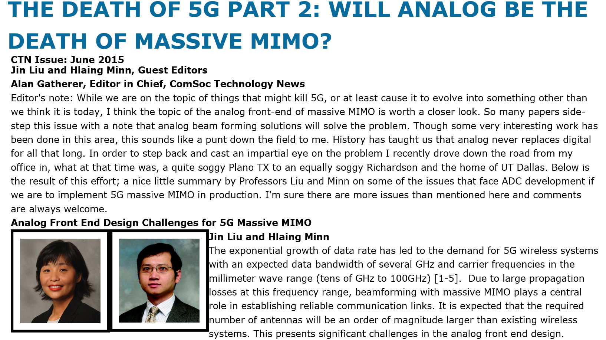
Challenges of mmWave massive MIMO
Challenges
  Traditional MIMO: one dedicated RF chain for one antenna
  Enormous number of RF chains due to large antenna array
  Unaffordable energy consumption (250 mW per RF chain at 60 GHz)
  MmWave massive MIMO BS with 256 antennas → 64 W (only RF)
  Micro-cell BS in 4G → several W (baseband + RF + transmit power)
How to reduce the number of required RF chains?
Notes:
However, realizing mmWave massive MIMO in practice is not a trivial task. One key challenge is that each antenna in MIMO systems usually requires one dedicated RF chain. This results in unaffordable hardware cost and energy consumption in mmWave massive MIMO systems, as the number of antennas becomes huge and the energy consumption of RF chain is high. For example, at 60 GHz, one RF chain will consume 250 mW. If we consider a mmWave massive MIMO base station (BS) with 256 antennas, only the RF chains will consume 64 Watts, which is much higher than the that of current 4G micro-cell BS. Therefore, how to reduce the number of required RF chains is an urging problem to be solved

Slide 5
Beamspace MIMO with lens antenna array
Basic idea^{[Brady’13]}
  Concentrate the signals from different directions (beams) on different antennas by lens antenna array
  Transform conventional spatial channel into beamspace (spatial DFT)
  Limited scattering at mmWave → beamspace channel is sparse
  Beam selection → significantly reduced MIMO dimension and RF chains
[Brady’13] J. Brady, et al., “Beamspace MIMO for millimeter-wave communications: System architecture, modeling, analysis, and measurements,” IEEE Trans. Ant. and Propag., Jul. 2013.
Notes:
To solve this problem, beamspace MIMO with lens antenna array has been recently proposed. By employing the lens antenna array, beamspace MIMO can transform the conventional spatial channel into beamspace channel by concentrating the signals from different directions (beams) on different antennas. Since the scattering at mmWave frequencies is not rich, the number of effective prorogation paths is quite limited, occupying only a small number of beams. Therefore, the beamspace channel is sparse, and we can select a small number of dominant beams to significantly reduce the MIMO dimension and the number of RF chains without obvious performance loss.

Slide 6
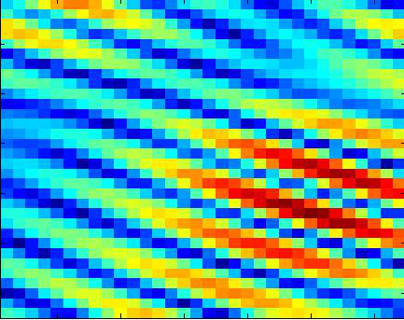
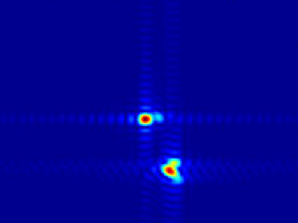
Beamspace channel
Spatial channel
Beamspace channel
Notes:
In this slide, we give some figures to explain beamspace MIMO more clearly. The figure in the top left corner is the prototype of beamspace MIMO built by Nokia. The figure in the top right corner shows the concentrating function of lens. The figure in the bottom left corner is the power distribution of the traditional spatial channel, while the last figure is the one of the beamspace channel. Obviously, with the help of lens antenna array, the beamspace channel becomes sparse.

Slide 7
Existing problem
3D Beamspace channel estimation
  Beam selection requires the information of beamspace channel
  Existing scheme based on the 2D beamspace channel model
  2D model → only horizontal degrees of freedom
  3D model → both horizontal and vertical degrees of freedom
  Few works on 3D beamspace channel estimation
How to estimate the 3D beamspace channel ?
Notes:
Nevertheless, beam selection acquires the information of beamspace channel of large size. However, most of the existing schemes are designed based on the 2D beamspace channel model, where only the horizontal degrees of freedom can be exploited. For the more general 3D beamspace channel model that can exploit both horizontal and vertical DoFs to achieve better performance, the beamspace channel estimation problem has not been addressed in the literature to the best of our knowledge.

Slide 8
3D beamspace channel model
System model
  single-antenna users, BS with antennas, RF chains
  Saleh-Valenzuela channel model [Ayach’14]
  where : spatial azimuth and : spatial elevation
  Transform the spatial channel into beamspace
  where
Sparse beamspace channel
DFT matrix realized by lens antenna array
[Ayach’14] O. El Ayach, et al., “Spatially sparse precoding in millimeter wave MIMO systems,” IEEE Trans. Wireless Commun., 2014.
Notes:
Here we make a brief description about the 3D beamspace channel model. Assume the base station employs a uniform planar array with N_1 elements in horizon and N_2 elements in vertical. Then, the 3D channel model in the spatial domain can be presented by this equation. And, with the help of DFT matrix U realized by lens antenna array, the 3D beamspace channel can be presented like this, which is our target.

Slide 9
Contents
1
Technical Background
2
Proposed Solution
3
Simulation Results
4
Conclusions
Notes:
To estimate the 3D beamspace channel, in our paper, we propose an adaptive support detection based scheme, as will be introduced next.

Slide 10
Channel estimation in TDD model
Channel measurements
  All K users transmit orthogonal pilot sequences to BS over Q instants
  Q instants are divided into M blocks ( ), during the mth block
  BS combines the received pilot signals by
  Consider user k, after M blocks, we have the channel measurements as
  If we use traditional selecting network to design the combiner
  Each row of will have one and only one nonzero element
  If contains complete information of → → high pilot overhead
pilot :
Notes:
We first review the procedure of channel estimation in TDD model. In summary, all the users need to transmit mutual orthogonal pilot sequences to base station overhead Q instants, as shown in the first equation. Here we assume Q can be divided into M blocks. During the mth block, the base station employs a combiner W to combine the received pilot signals like the second equation. If we only focus on the user k, then the channel measurements can be presented by this equation. It is worth pointing out that if we use traditional selecting network to design the combiner, each row of W will have one and only one nonzero element. This means that when Q is larger than N, the measurement vector z_k_bar cannot contain the complete information of the channel. In this case, the pilot overhead will be unaffordable.

Slide 11
Adaptive selecting network
Adaptive selecting network^{[Gao’16]}
  Utilize 1-bit phase shifter (PS) network to design
  Adaptivity: selecting network for data transmission & combiner for channel estimation
  , has full information → sparse signal recovery problem
  1-bit PS → Low energy consumption
[Gao’16] X. Gao, et al., “Reliable beamspace channel estimation for millimeter-wave massive MIMO systems with lens antenna array,” IEEE Trans. Wireless Commun., Major revision, 2016.
Notes:
To this end, we adopt the adaptive selecting network proposed in our previous work. Its key idea is to replace the traditional selecting network by a 1-bit phase shifter network as shown in this figure. During the data transmission, we can turn off some phase shifters to realize beam selection, while during the beamspace channel estimation, we can realize the combiner to obtain more efficient channel measurements. With the help of the adaptive selecting network, when Q < N, we can still guarantee that z_k_bar contains complete channel information, and the pilot overhead can be significantly reduced. Moreover, as the channel h_k is a sparse vector, the beamspace channel estimation problem in the previous slide can be formulated as a typical sparse signal recovery problem.

Slide 12

Structural property 1
Classical CS algorithms
  Deteriorated performance in low SNR region
  Low transmit power at user side
  Serious path loss of mmWave signals
  Lack of beamforming gain
Low SNR
We should utilize the structural properties of 3D beamspace channel
Lemma 1. Present as , where is the lth channel component of in the beamspace. Then, when the number of BS antennas N goes infinity, any two channel components and are orthogonal, i.e.,
Insights
  The total estimation problem can be decomposed into a series of independent sub-problems
  Each sub-problem only considers one channel component
Notes:
Based on this formulation, we can use the classical CS algorithms, such as OMP to estimate the 3D beamspace channel. However, when the SNR is low, the performance of classical algorithms is deteriorated. Unfortunately, low SNR is a typical case for channel estimation in mmWave communications, since transmit power of user is low and the beamforming gain to overcome serious path loss is lacked. To achieve satisfying performance in the low SNR region, we need to utilize the structural properties of 3D beamspace channel. The first property is proved in Lemma 1. It shows that when the number of antennas goes infinity, the 3D beamspace channel can be presented as the summation of several mutual orthogonal channel components. This means that the total estimation problem can be decomposed into a series of independent sub-problems, each of which only considers one channel component.

Slide 13
Structural property 2
Lemma 2. Define matrix as . Define as the sub-matrix of extracting strongest rows and strongest columns from . Assume
and are even integers without loss of generality. Then, the ratio between the power of
and the power of can be lower-bounded by
Insights
  can be considered as a block sparse matrix
  Indices extracted rows and columns are is uniquely determined by
  Support of is
Notes:
The second structural property is proved in Lemma 2. We reshape the lth channel component as an N1 times N2 matrix C_l_wave, then we can observe that most power of this channel component is concentrated on a sub-matrix S of C_l_wave. This indicates that C_l_wave can be well-approximated as a block sparse matrix. Moreover, the indices of the extracted rows and columns of the sub-matrix S are uniquely determined by the position of the strongest element of C_l_wave.

Slide 14
Adaptively support detection (ASD) algorithm
Key idea
  Estimate the strongest element →
  Assume to obtain the initial support
  Estimate nonzero elements, and define four marginal values
  Serious vertical power diffusion
  Serious horizontal power diffusion
Notes:
Based on these observations, we propose an adaptively support detection algorithm. It can be divided into two stages. In the first stage, we estimate the strongest element of C_l_wave, and obtain an initial support by assuming that V1 equals V2. In the second stage, we estimate the corresponding nonzero elements and define four marginal values like these. Then, we can determine the power diffusions in the horizontal and vertical directions, and adaptively adjust V1 and V2 to improve the support accuracy.

Slide 15
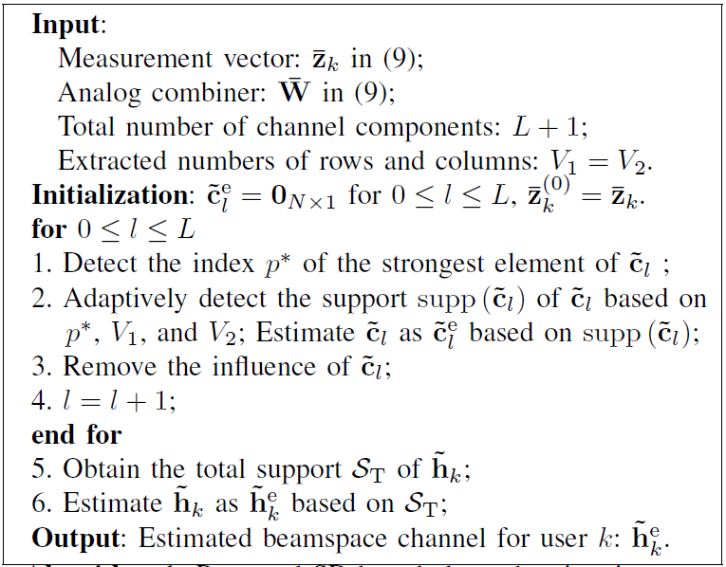
ASD-based 3D beamspace channel estimation
Notes:
In this slide, we make a summary of our proposed ASD-based 3D beamspace channel estimation scheme. The pseudo-code is provided in the left hand and the illustration figure is provided in the right hand. Here, we explain some key steps. During the lth iteration, in step 1, we first detect the position of the strongest element of each channel component. Then, in step 2, we adaptively detect the support of this channel component by ASD algorithm. After the lth channel component has been estimated, we remove its influence for next iteration in step 3. Finally, after the supports of all components have been detected, we can obtain the complete support in step 5, and estimate the 3D beamspace channel with low pilot overhead.

Slide 16
Contents
1
Technical Background
2
Proposed Solution
3
Simulation Results
4
Conclusions
Notes:
Next, we provide the simulation results to verify the advantages of our scheme.

Slide 17
Simulation parameters
System parameters
  MIMO configuration:
  Total time slots:
  Initialization for ASD algorithm:
  Combiner : Bernoulli random matrix, i.e.,
Channel parameters
  Channel model: Saleh-Valenzuela model
  Antenna array: UPA at BS, with antenna spacing
  Multiple paths: One LoS component and two NLoS components
  LoS component
  Amplitude: Spatial direction:
  NLoS components
  Amplitude: Spatial direction:
Notes:
The simulation parameters are set as follows. The BS employs a lens antenna array with 32 elements in horizon and 32 elements in vertical to serve 16 single-antenna users. The number of RF chains is also set as 16. The instants for pilot transmission is 256. At the beginning, we set the ASD algorithm parameters V1 and V2 as 8. The combiner realized by adaptive selecting network is set as the Bernoulli random matrix. The channel is generated following the Saleh-Valenzuela multipath model, where we assume one LoS path and two NLoS paths.

Slide 18
Simulation results
Observations
  ASD-based channel estimation outperforms conventional scheme
  The performance is satisfying even in the low SNR region
  The pilot overhead is low, i.e.,
Accurately estimate the beamspace channel with low pilot overhead and low SNR!
Notes:
The figure shows the MSE performance comparison, where the blue line is the conventional OMP channel estimation and red line is our scheme. We can observe that our scheme performs better, specially in the low SNR region. It is also worth pointing out that by using the idea of compressive sensing, the pilot overhead of our scheme is also low.

Slide 19
Contents
1
Technical Background
2
Proposed Solution
3
Simulation Results
4
Conclusions
Notes:
Finally, we make a brief summary of our paper.

Slide 20
Summary
ASD-based 3D beamspace channel estimation
  We propose to decompose the total estimation problem into a series of sub-problems, each of which only considers one sparse channel component
  We propose to utilize the structural properties of 3D beamspace channel to detect an initial support of each sparse channel component
  We propose to adaptively refine the support according to the different power diffusion of 3D beamspace channel in the horizontal and vertical directions
Advantages
  Our scheme can detect support with higher accuracy
  Our scheme enjoys better NMSE performance, even in the low SNR region
  Our scheme involves quite low pilot overhead
Notes:
The contributions of this paper can be summarized as follows: firstly, we…; secondly, we…; finally, we…. It is shown that our scheme can detect the support with higher accuracy, and therefore achieve better NMSE performance, even with low SNR. More importantly, it has been shown that our scheme enjoys quite low pilot overhead, which makes it attractive for practical systems.

Slide 21
Thanks for your attention !
Notes:
That’s all. Thanks for your attention!

